Slide 1
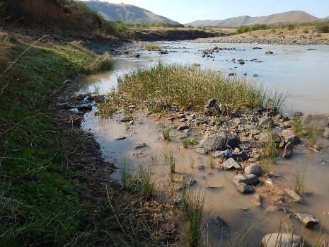
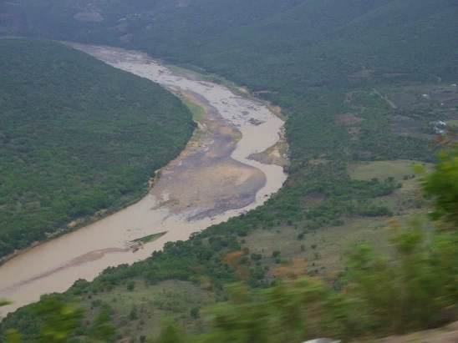
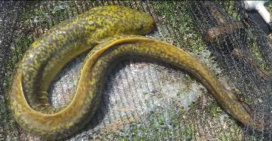
WP 11004: PSC MEETING 4, 15 MAY 2018
PRESENTATION TITLE
Presented by:
Name Surname
Directorate
Date
DETERMINATION OF WATER RESOURCE CLASSES AND RESOURCE QUALITY OBJECTIVES FOR THE WATER RESOURCES IN THE MZIMVUBU CATCHMENT:
GROUNDWATER RQOs
Karim Sami

Slide 2
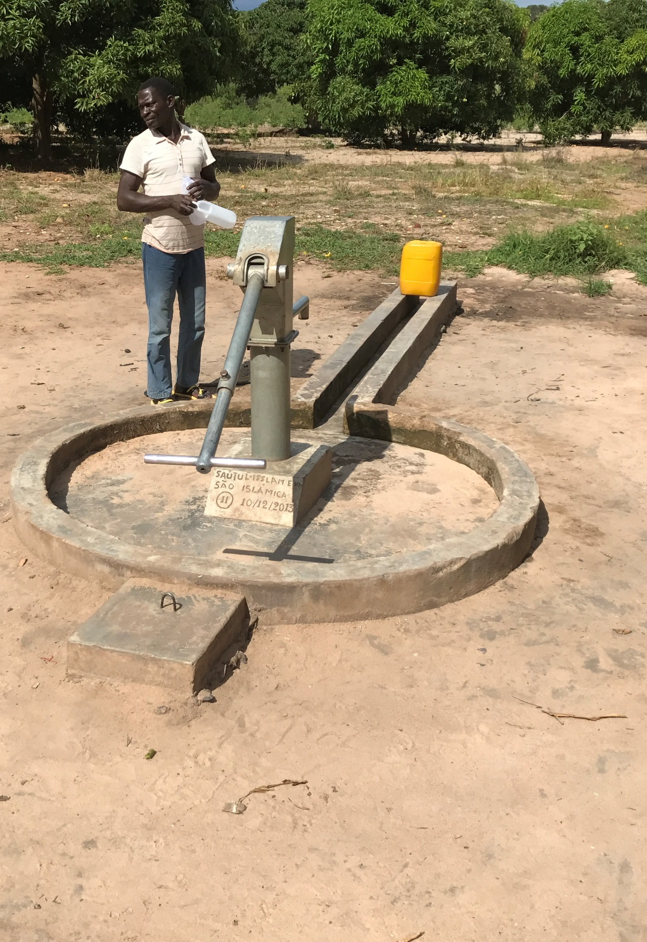
GROUNDWATER RQOs

Slide 3
GW CONTRIBUTION TO THE RESERVE
GW component of the Reserve for each GRU is calculated by:
Reserve = (EWRgw + BHNgw), where:
BHNgw = basic human needs derived from groundwater
EWRgw = groundwater contribution to EWR
Groundwater contributions for the EWR include:
Baseflow to rivers and springs, including high lying springs fed by interflow.
Seepage to wetlands and groundwater dependent ecosystems.
The allocable groundwater is the difference between recharge and the groundwater component of the Reserve; and should not exceed 65% to ensure sustainability.

Slide 4
HOW DOES WATER USE AFFECT GW?
Abstraction: Reduction of groundwater baseflow by interception of GW or by drawdown and gradient reversal near rivers.
Alien Invasive Plants (AIPs): increased evaporation of shallow groundwater or reduce interflow from high lying areas.

Slide 5
AIMS
Maintain the required groundwater contribution to the EWR
Protect groundwater resources for the direct and indirect users
RQOs may stipulate:
the volume of abstraction that would cause an undesirable reduction in baseflow or undue stress on aquifer
specific distances from a river
flow at gauging stations and maximum baseflow reduction
GW levels
water quality conditions (linked to potable use)

Slide 6
CRITERIA USED FOR SETTING RQOs
Abstraction: Harvest Potential, Allocable Groundwater
Baseflow: Distance of abstraction from river, low flows at gauging stations
Water level: trends
Water quality: monitoring where poor quality is an issue
Water Quality Classes (Potability):
Class I: 95% of samples of water quality class 0 and 1
Class II: 75% of samples of water quality class 0-2
Class III: <75% of samples class 0-2

Slide 7
GROUNDWATER CLASSIFICATION BY STRESS AND RESOURCE QUALITY
GW present status | Description | Guide | Stress index
A | Unmodified, pristine conditions | Very limited use (GW use is less than 5% of recharge) | ≤ 0.05
B | Low volume GW usage, largely natural conditions, no negative impacts apparent | Stock watering, farm domestic water supply, rural water supply (use ranges between 5% and 20% of recharge) | 0.05 – 0.2
C | Moderate volumes of GW usage, little or no negative impacts apparent | Small-scale irrigation, rural water supply, water supply for villages and small towns (use ranges between 20% and 40% of recharge) | 0.2 – 0.4
D | High volumes of GW usage, but with little apparent negative impact | Water supply for large rural communities, medium to large towns, large-scale irrigation (use ranges between 40% and 65% of recharge) | 0.4 – 0.65
E | Stressed system due to over-abstraction of GW or inappropriate land-use | High volume of major groundwater users (use range between 65% and 95% of recharge) | 0.65 – 0.95
F | Critical over-abstraction of GW or highly sensitive hydrological environment | Very high volume of major groundwater users (GW use is in excess of 95% of recharge) | > 0.95
Note: usage of 65% (D) = lowest limit of sustainability for GW use + protection.
Note that the GW present status categories are NOT directly linked to Ecological Categories used for rivers and estuaries.

Slide 8
STRESS INDEX

Slide 9
GROUNDWATER USE IN T3
Aquifer Recharge = 491.711 Mm3/a)
WARMS = 12.72 Mm³/a
The fraction of boreholes that are potable (potability index) exceeds 85%, except in T35K + T33H.

Slide 10
EXAMPLE OF RQOs - ABSTRACTION
Quat | Groundwater narrative RQO | Groundwater numerical RQO
 | Abstraction | Baseflow | Water Level | Water Quality
T31F | All users to comply with existing allocation schedules, including the GA and Schedule 1, and individual licence conditions within the Harvest Potential | Due to groundwater contribution to baseflow, abstraction within 100 m of perennial rivers should be restricted to use less than the GA . | Water level monitoring required near Cedarville and areas of high abstraction. No downward trend of static water level should be seen over a period of 5 years | No water quality monitoring required | The Allocable groundwater is 5.487 Mm³/a
Allocable = 65% of Aquifer recharge - Reserve

Slide 11
BASEFLOW REDUCTION

Slide 12
EXAMPLE OF RQOs- BASEFLOW
Quat | Groundwater narrative RQO | Groundwater numerical RQO
 | Abstraction | Baseflow | Water Level | Water Quality
T35C, T35F | All users to comply with existing allocation schedules and individual licence conditions within the Harvest Potential | Due to baseflow depletion, further SFR activities should be avoided, especially, within 100 m of perennial stream. | Due to the low groundwater use and low aquifer contribution to baseflow, monitoring not required | Some boreholes may have elevated natural nitrate and fluoride levels, so nitrate and fluoride need to be tested for domestic boreholes. Insufficient data exists, and data collection is required | Low flows at T3H009 should not be less than an average of 8.92 Mm³/a for T35C. T35F is ungauged and cannot be monitored by flow measurements

Slide 13
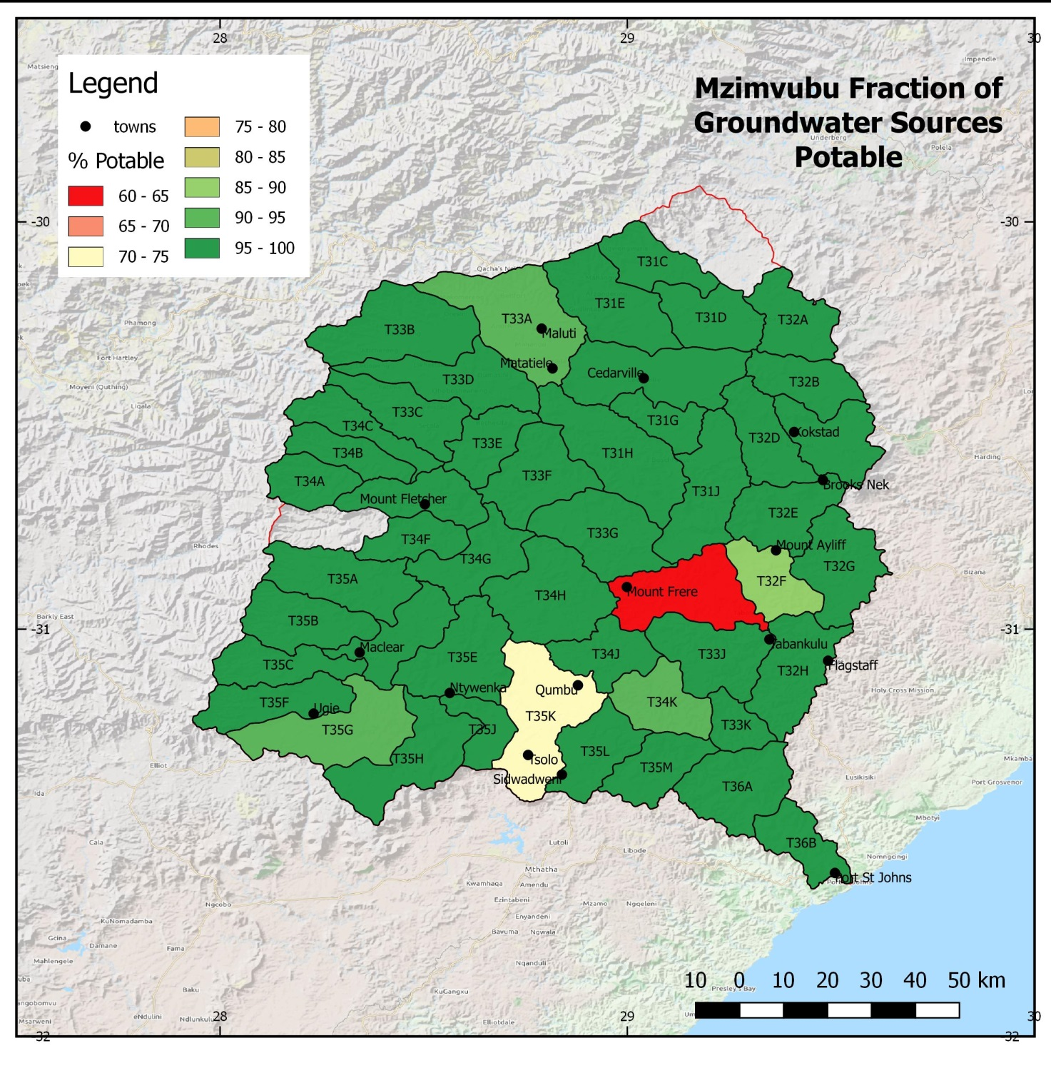

Slide 14
CONCLUSIONS (1)
Groundwater in all catchments under-utilised.
Total use = 22 MCM/a, harvest potential = 317 MCM/a, aquifer recharge = 492 MCM/a.
Allocable Groundwater = 263 Mm³/a.
Of the 51 quaternary catchments, 42 have a GW Present Status of A (stress index < 0.05), 7 as B (stress index < 0.2), and only 2 are classified as C (stress index < 0.4).
Cumulative baseflow = 2 899 MCM/a; of which 87% is derived as interflow from springs above the regional groundwater level.
Groundwater low flow EWR is 573.56 MCM/a.
Groundwater-supported BHNR is 6.2 MCM/a.
Groundwater component of the Reserve = 580 MCM/a, which is only 2.9% of recharge.

Slide 15
CONCLUSIONS (2)
241 MCM/a of groundwater can still be allocated.
Groundwater quality is good: 85% of samples Class 0, 8% Class 1, 2% Class 2, and 5% Class 3 and 4 samples.
PRIORITY MONITORING AREAS FOR WATER LEVEL AND ABSTRACTION
Catchment Stress Index Priority
T31F 0.341 Moderate
T33A 0.371 Moderate
PRIORITY MONITORING AREAS FOR BASEFLOW REDUCTION
Catchment Baseflow Reduction Priority
T35F 43.85 Moderate
T35C 30.43 Moderate

Slide 16
CONCLUSIONS (3)
PRIORITY MONITORING AREAS FOR WATER QUALITY
Over large parts of the study area insufficient data exist to characterise groundwater quality. The T33-T36 tertiary catchments lack sufficient data.
Catchments T35K and T33H have a high proportion of boreholes with elevated salinities; cause unknown.

Slide 17
QUESTIONS FOR CLARIFICATION

